Slide 1
Spring Web MVC
By: Zeeshan Hanif Sr. Software Engineer
Etilize Pvt. Ltd.
A GfK Product data company

Slide 2
Agenda
What is spring MVC
Features
Spring MVC Workflow
Important Components of Spring MVC
Demo – External configuration
Demo – Annotation
Convention over Configuration
World without Rules
Demo – Form Submission
Demo – Session Storage
Demo – REST based URL
Demo – Ajax

Slide 3
Prerequisite
Spring Core
IOC & Dependency Injection

Slide 4
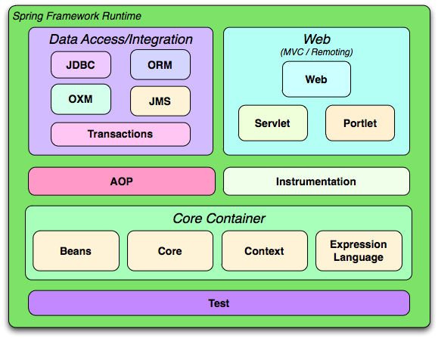
Source: www.springsource.org

Slide 5
Spring MVC
The Spring Web MVC Framework is a robust, flexible, and well-designed framework for rapidly developing web applications using the MVC design pattern.

Slide 6
Features
Clear separation of roles. Each role — controller, validator, command object, form object, model object, handler mapping, view resolver and so on.
Powerful and straightforward configuration of both framework and application classes as JavaBeans
Adaptability and flexibility. Define any controller method signature you need for a given scenario

Slide 7
Features (cont.)
Use existing business objects as command or form objects instead of mirroring them to extend a particular framework base class
Flexible model transfer. Model transfer with a name/value Map supports easy integration with any view technology
A simple yet powerful JSP tag library
Easier testing
REST based URL support

Slide 8
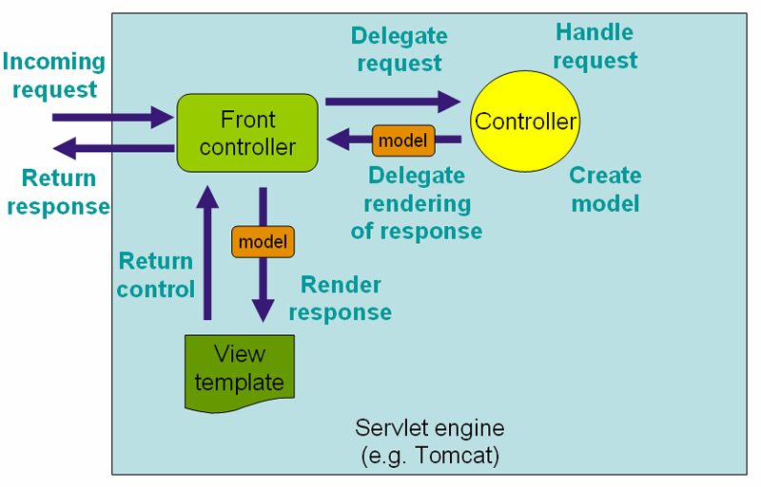
Spring MVC Workflow
Source: www.springsource.org

Slide 9
Important Components
DispatcherServlet
Controller
HandlerMapping/@RequestMapping
ModelAndView
Model & @ModelAttribute
ViewResolver

Slide 10
DispatcherServlet
The Dispatcher Servlet follows the Front Controller Design Pattern for handling Client Requests.
It means that whatever Url comes from the Client, this Servlet will intercept the Client Request before passing the Request Object to the Controller.

Slide 11
DispatcherServlet (cont.)
<web-app>
<servlet>
<servlet-name>dispatcher</servlet-name>
<servlet-class> org.springframework.web.servlet.DispatcherServlet
</servlet-class>
<load-on-startup>1</load-on-startup>
</servlet>
<servlet-mapping>
<servlet-name>dispatcher</servlet-name>
<url-pattern>*.gfk</url-pattern>
</servlet-mapping>
</web-app>

Slide 12
Controller
Controllers are components that are being called by the Dispatcher Servlet for doing any kind of Business Logic
Spring Distribution already comes with a variety of Controller Components each doing a specific purpose - spring 2.x
SimpleFormController
AbstractController
MultiActionController
Spring 3 Controller
@Controller Annotation

Slide 13
Controller (Cont.)
Old School of Spring MVC
public class MySimpleController extends AbstractController {
public ModelAndView handleRequestInternal (HttpServletRequest request,
HttpServletResponse response)
{
return new ModelAndView("myView");
}
}

Slide 14
Controller (Cont.)
Spring MVC 3.0
@Controller
public class DemoSpring3Controller {
@RequestMapping("/demoSpring3")
public ModelAndView helloWorld() {
String msg = "Hello Spring 3 World! Etilize -- GfK";
return new ModelAndView("demosp",
"message", msg);
}
}
<context:component-scan base-package="com.gfk.etilize.controller" />

Slide 15
HandlerMapping
A Handler Mapping provides an abstract way that tell how the Client's Url has to be mapped to the Handlers.
Four concrete variation of Handler Mapping are available
BeanNameUrl HandlerMapping
CommonsPathMap HandlerMapping
ControllerClassName HandlerMapping
SimpleUrl HandlerMapping

Slide 16
HandlerMapping (Cont.)
BeanNameUrl HandlerMapping
URL request
http://localhost:8080/spweb/showStudents
Bean Mapping
<beans>
<bean id="beanNameUrl" class="org.springframework.web.servlet.handler.BeanNameUrlHandlerMapping"/>
<bean name="/showStudents.jsp" class="com.gfk.etilize.ShowStudentsController">
</bean>
</beans>

Slide 17
HandlerMapping (Cont.)
SimpleUrlHandlerMapping
<bean id="urlMapping" class="org.springframework.web.servlet.handler.SimpleUrlHandlerMapping">
<property name="urlMap">
<map>
<entry key="/demoSpring.gfk">
<ref bean="demoSpringController"/>
</entry>
</map>
</property>
</bean>
<bean id="demoSpringController" class="com.gfk.etilize.controller.DemoSpringController" />

Slide 18
HandlerMapping (Cont.)
Spring 3.0 uses @RequestMapping for Mapping
@Controller
public class DemoSpring3Controller {
@RequestMapping("/demoSpring3")
public ModelAndView helloWorld() {
String msg = "Hello Spring 3 World";
return new ModelAndView("demosp", "message", msg);
}
}

Slide 19
ModelAndView
ModelandView is returned by the Controller object back to the Dispatcher Servlet.
This class is just a Container class for holding the Model and the View information.
This way of specifying a View is called a Logical View. It means that demosp either can point to something called demosp.jsp or demosp.pdf or demosp.xml
ModelAndView(viewName, “Key”, object);
return new ModelAndView("demosp", "message", msg);

Slide 20
Model & @ModelAttribute
Model object Automatically created on every request
@RequestMapping
public void showList(Model model){
model.addAttribute("studentList", studentService.getAllStudents());
}
Implicitly added to Model and can be accessed with key “student”
@RequestMapping
public Student showList(){
return studentService.getStudent();
}

Slide 21
Model & @ModelAttribute
@ModelAttribute – customized name
@RequestMapping
public @ModelAttribute(“stu”) Student showList(){
return studentService.getStudent();
}
@ModelAttribute – Form values
@RequestMapping("/new")
public ModelAndView getStudentForm(){
return new ModelAndView("studentForm","student",new Student());
}
<form:form action="add.gfk" method="POST" commandName=" student " >
Name:<form:input path="name" size="60" /><br>
<input type="submit" value="Register" /></td>
</form:form>
@RequestMapping
public void saveStudent(@ModelAttribute Student stu){
studentService.saveStudent(stu);
}

Slide 22
View Resolver
The mapping between the Logical name and the Physical View Location is taken care by the View Resolver object.
Spring comes with a set of Built-In Spring Resolvers.
We can write Custom View Resolvers by implementing the org.springframework.web.servlet.ViewResolver interface

Slide 23
View Resolver (Cont.)
BeanNameViewResolver
FreeMarkerViewResolver
InternalResourceViewResolver
JasperReportsViewResolver
ResourceBundleViewResolver
UrlBasedViewResolver
VelocityLayoutViewResolver
VelocityViewResolver
XmlViewResolver
XsltViewResolver

Slide 24
View Resolver (Cont.)
InternalResourceViewResolver
Controller returns - new ModelAndView("myView1")
<bean id="viewResolver“ class="org.springframework.web.servlet.view.InternalResourceViewResolver">
<property name="prefix">
<value>/WEB-INF/</value>
</property>
<property name="suffix">
<value>.jsp</value>
</property>
</bean>
the prefix + the logical View Name + the suffix
/WEB-INF/myView.jsp

Slide 25
View Resolver (Cont.)
BeanNameViewResolver
One of the dis-advantage of using InternalResourceViewResolver is that the name of the View file (jsp or pdf) must be present in the Web Application Context.
Dynamically generated View files may not be possible.
In such a case, we may use the BeanName ViewResolver which will dynamically generate View in Pdf or Excel Formats.

Slide 26
View Resolver (Cont.)
Controller returns - new ModelAndView(“excel")
<bean id="beanNameResolver" class="org.springframework.web.servlet.view.BeanNameViewResolver"/>
<bean id = “excel" class = "MyExcelGenerator"/>

Slide 27
Demo – External configuration Demo – Annotation

Slide 28
Convention over Configuration
Write less code, get consistency
Conventions available for
Request mapping
View name selection
Model population

Slide 29
Convention over Configuration
Mapping By RequestMapping
@Controller
public class DemoSpring3Controller {
@RequestMapping("/demoSpring3")
public void helloWorld(){}
}

Slide 30
Convention over Configuration
@Controller
public class StudentController {
@RequestMapping
public void listAll(Model model){
model.addAttribute(new Student("Test",23));
}
}
GET /student/listAll
Mapping of class and
method name
Model key generated from object type
View with method name selected from request path

Slide 31
Convention over Configuration
Mapping By Convention
@Controller
public class StudentController {
URL → /student/showList , View → showList.jsp
@RequestMapping
public void showList(Model model){}
URL → /student/getStudent, View → getStudent.jsp
@RequestMapping
public Student getStudent(){
…
return stu;
}
}

Slide 32
World without Rules
Return Type?
Return Type Can be:
ModelAndViewObject
Model
Map
View
String
Void
Any Custom or built-in datatype
e.g. Student, Student[],ArrayList etc.

Slide 33
World without Rules (Cont.)
Parameter Type?
Parameter can be in any order:
ServletRequest/HttpServletRequest
ServletResponse/HttpServletResponse
HttpSession
InputStream/java.io.Reader
OutputStream/java.io.Writer
@RequestParam("product") int id or any type
@PathVariable String name or any type
@CookieValue("cookie_name") String or any type
@RequestHeader("content") String or any type
@ModelAttribute User us or any custom object
Errors
BindingResult
SessionStatus

Slide 34
Demo – Form Submission

Slide 35
@RequestParam
Type Conversion
@RequestMapping("/login")
public void login(@RequestParam String userName, @RequestParam int age){
}
Optional Request parameter -- must use object for optional
@RequestMapping("/login")
public void login(@RequestParam(required=false) String userName){
}

Slide 36
Demo – @RequestParam

Slide 37
@SessionAttribute
@Controller
@SessionAttributes("user")
public class LoginController {
@RequestMapping("/login")
public User login(@RequestParam int id){
return loginService.login(id);
}
}
User Object will be stored in session with key “user”

Slide 38
Demo – @SessionAttribute

Slide 39
@PathVariable – REST URLs
GET /students/find/5
@RequestMapping(“/find/{id}")
public ModelAndView findStudent(@PathVariable int id ,
Model model){
model.addAttribute("stu", studentService.getStudent(id));
return new ModelAndView("searchStudent");
}

Slide 40
Demo – @PathVariable – REST URLs

Slide 41
Demo – Ajax
@ResponseBody annotation instructs Spring MVC to serialize the Student to the client.
Spring MVC automatically serializes to JSON because the client accepts that content type
@RequestMapping(value="/student")
public @ResponseBody Student getStudent(
@RequestParam int id) {
return studentService.getStudent(id);
}

Slide 42
Q & A

Slide 43
Source Code
http://www.4shared.com/zip/sHRtnXXd/DemoSpringMVC.html
You can find this presentation on slideshare
http://www.slideshare.net/zeeshanhanif

Slide 44
Contact
zeeshanhanif@gmail.com
http://www.linkedin.com/in/zeeshanhanif
http://www.facebook.com/zeeshanhanif

